Slide 1
Clustering
Implementation
Yingchao Du

Slide 2
Outline
Metrics:
Hamming distance
Classification error
Silhouette coefficient
Clustering Algorithms:
Single linkage
Complete linkage
Average linkage
Lloyd’s method

Slide 3
Data Sets
Data Sets | Number of Instances | Number of Attribute | Number of Target Attribute Value
IRIS | 150 | 4 | 3
Seeds | 210 | 7 | 3
Wine | 178 | 13 | 3

Slide 4
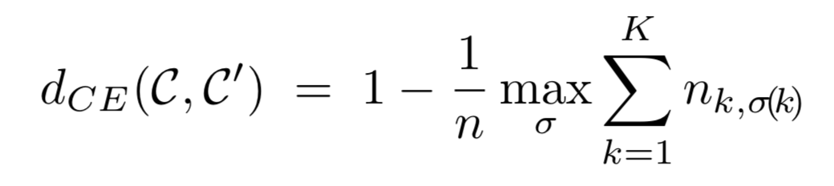
Classification Error
In the above, it is assumed w.l.o.g that K ≤ K′, σ is an injective mapping of {1,...K} into {1,...K′}, and the maximum is taken over all such mappings.

Slide 5
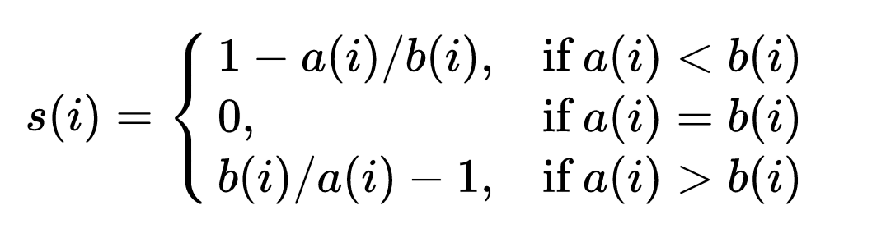
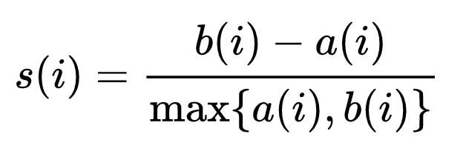
Silhouette Coefficient
Let a(i) be the average distance between i and all other data within the same cluster.
Let b(i) be the lowest average distance of i to all points in any other cluster, of which i is not a member.
or

Slide 6
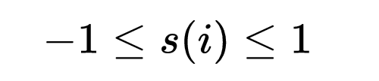
Silhouette Coefficient
s(i) close to 1, appropriate,
s(i) close to -1, not appropriate
s(i) close to 0, on the border of two clusters
The average s(i) over all data of the entire dataset is a measure of how appropriately the data have been clustered.
Notes:
For {\displaystyle s(i)} to be close to 1 we require {\displaystyle a(i)\ll b(i)}. As {\displaystyle a(i)} is a measure of how dissimilar {\displaystyle i} is to its own cluster, a small value means it is well matched. Furthermore, a large {\displaystyle b(i)} implies that {\displaystyle i} is badly matched to its neighbouring cluster. Thus an {\displaystyle s(i)} close to one means that the data is appropriately clustered. If {\displaystyle s(i)} is close to negative one, then by the same logic we see that {\displaystyle i}would be more appropriate if it was clustered in its neighbouring cluster. An {\displaystyle s(i)} near zero means that the datum is on the border of two natural clusters.

Slide 7
Results - Hamming Distance
Data Sets | Single Linkage | Complete Linkage | Average Linkage | Lloyd’s Method
IRIS | 0.2234 | 0.1632 | 0.1077 | 0.1203
Seeds | 0.6430 | 0.2050 | 0.1233 | 0.1263
Wine | 0.6372 | 0.2855 | 0.3738 | 0.2813
Wine after Nomalization | 0.6573 | 0.0853 | 0.6573 | 0.0585

Slide 8
Results - Classification Error
Data Sets | Single Linkage | Complete Linkage | Average Linkage | Lloyd’s Method
IRIS | 0.3200 | 0.1600 | 0.0933 | 0.1067
Seeds | 0.6268 | 0.1962 | 0.1005 | 0.1053
Wine | 0.5730 | 0.3258 | 0.3876 | 0.2978
Wine after Nomalization | 0.6124 | 0.0674 | 0.6124 | 0.0449

Slide 9
Results - Silhouette Coefficient
Data Sets | Single Linkage | Complete Linkage | Average Linkage | Lloyd’s Method
IRIS | 0.5118 | 0.5134 | 0.5540 | 0.5526
Seeds | 0.0652 | 0.4404 | 0.4586 | 0.4709
Wine | 0.4936 | 0.5419 | 0.6101 | 0.5711
Wine after Normalization | 0.1599 | 0.2736 | 0.1476 | 0.3013

Slide 10
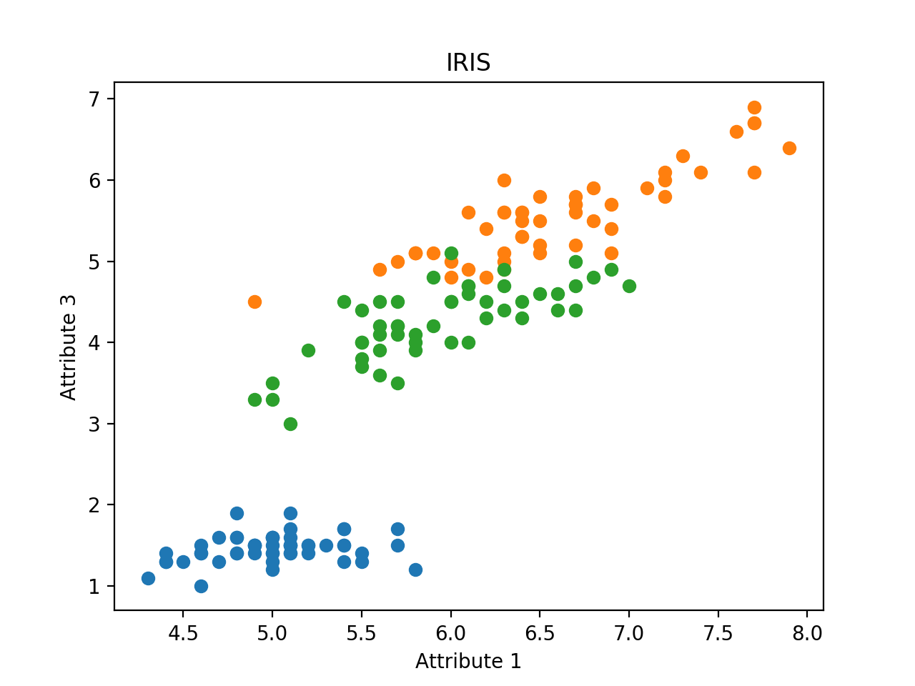
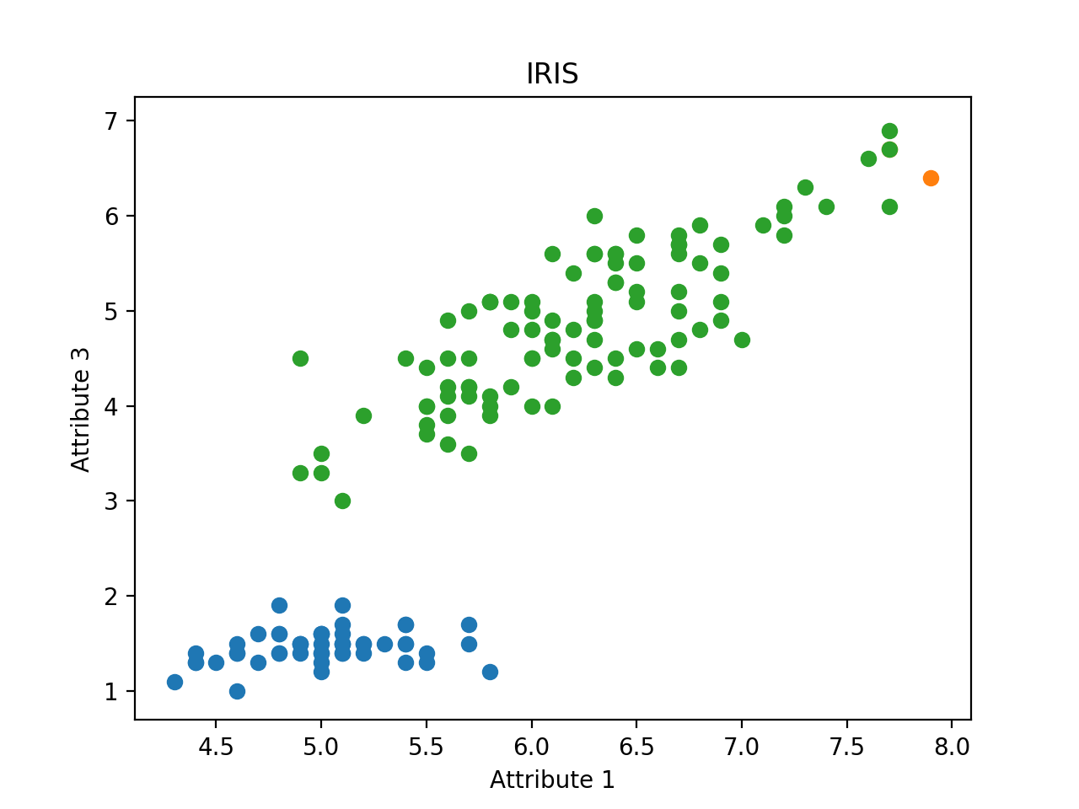
Results - Graph - IRIS
clusters from labels
clusters from single linkage

Slide 11
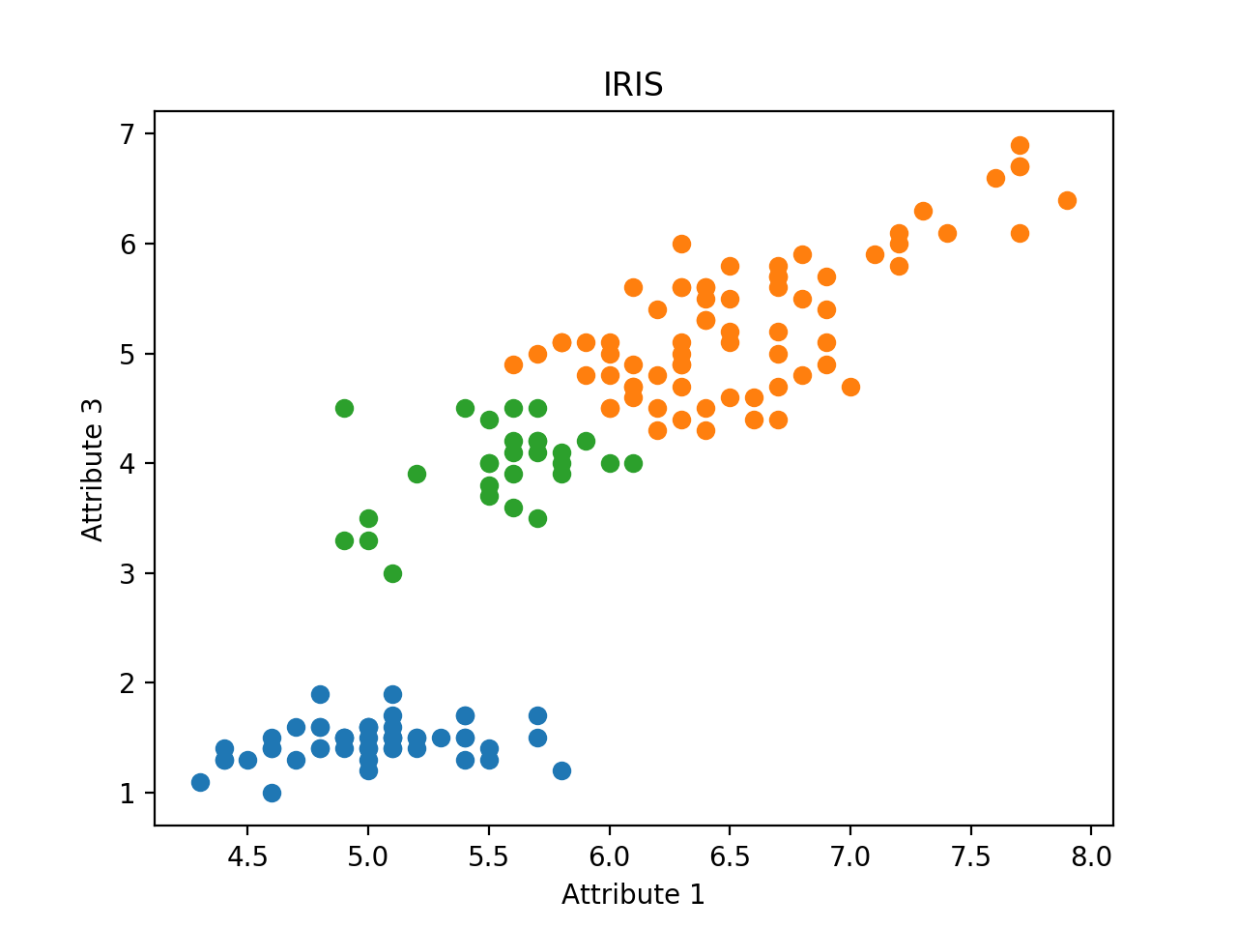
Results - Graph - IRIS
clusters from labels
clusters from complete linkage

Slide 12
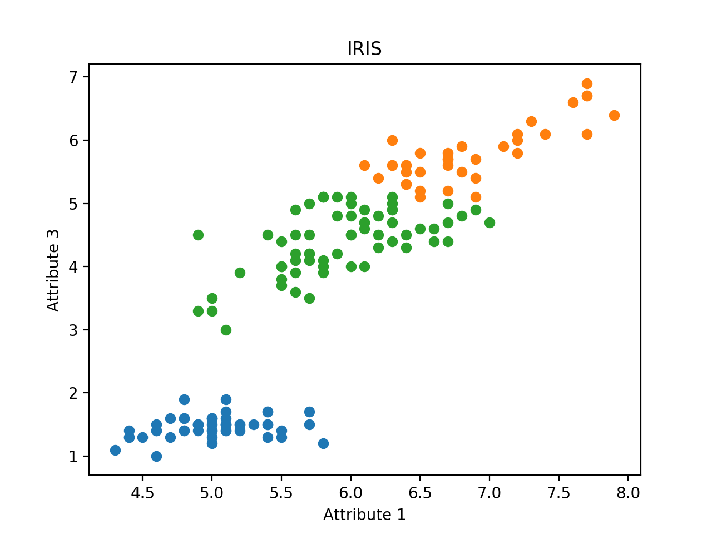
Results - Graph - IRIS
clusters from labels
clusters from average linkage

Slide 13
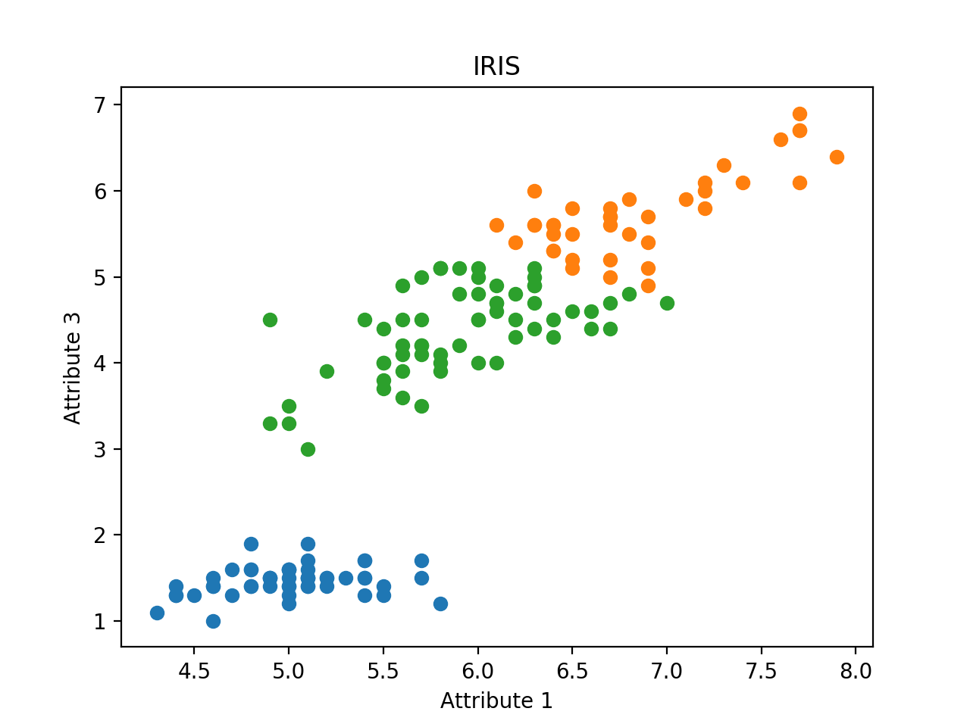
Results - Graph - IRIS
clusters from labels
clusters from Lloyd’s method

Slide 14
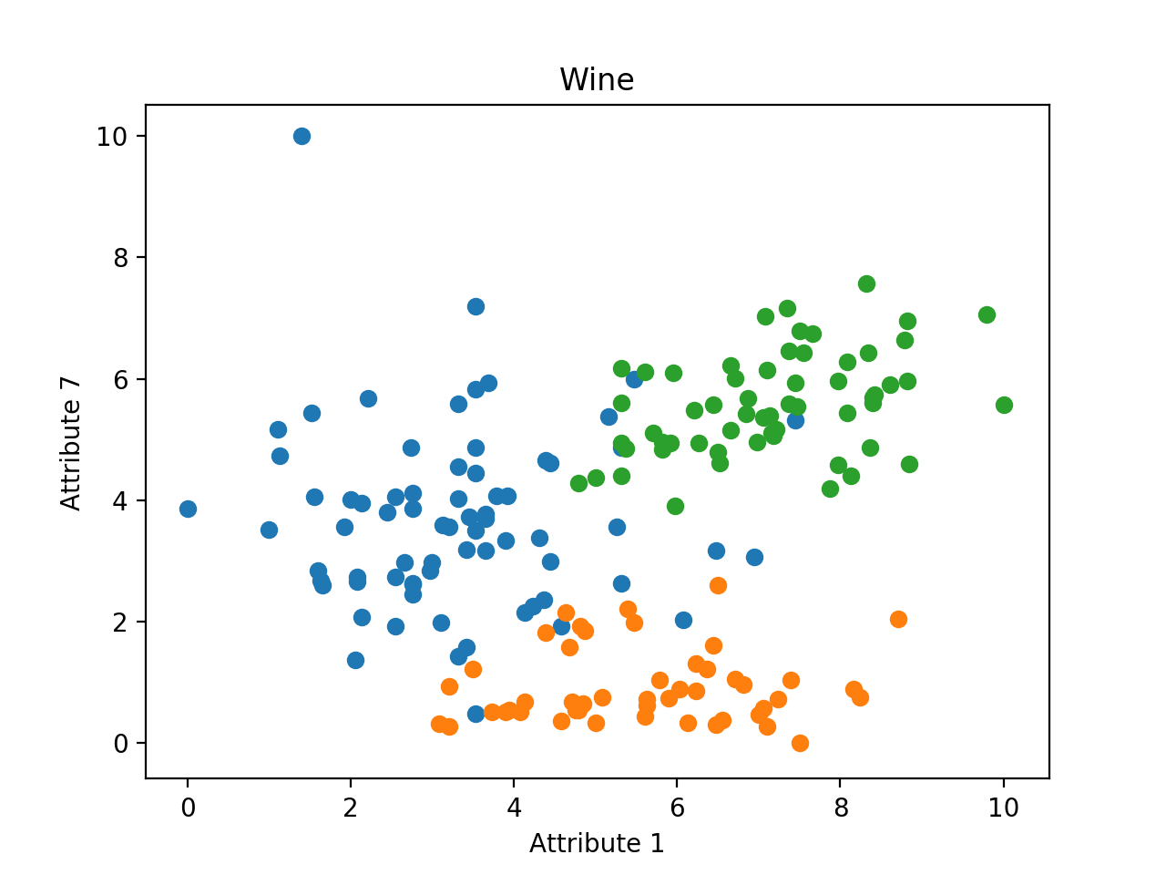
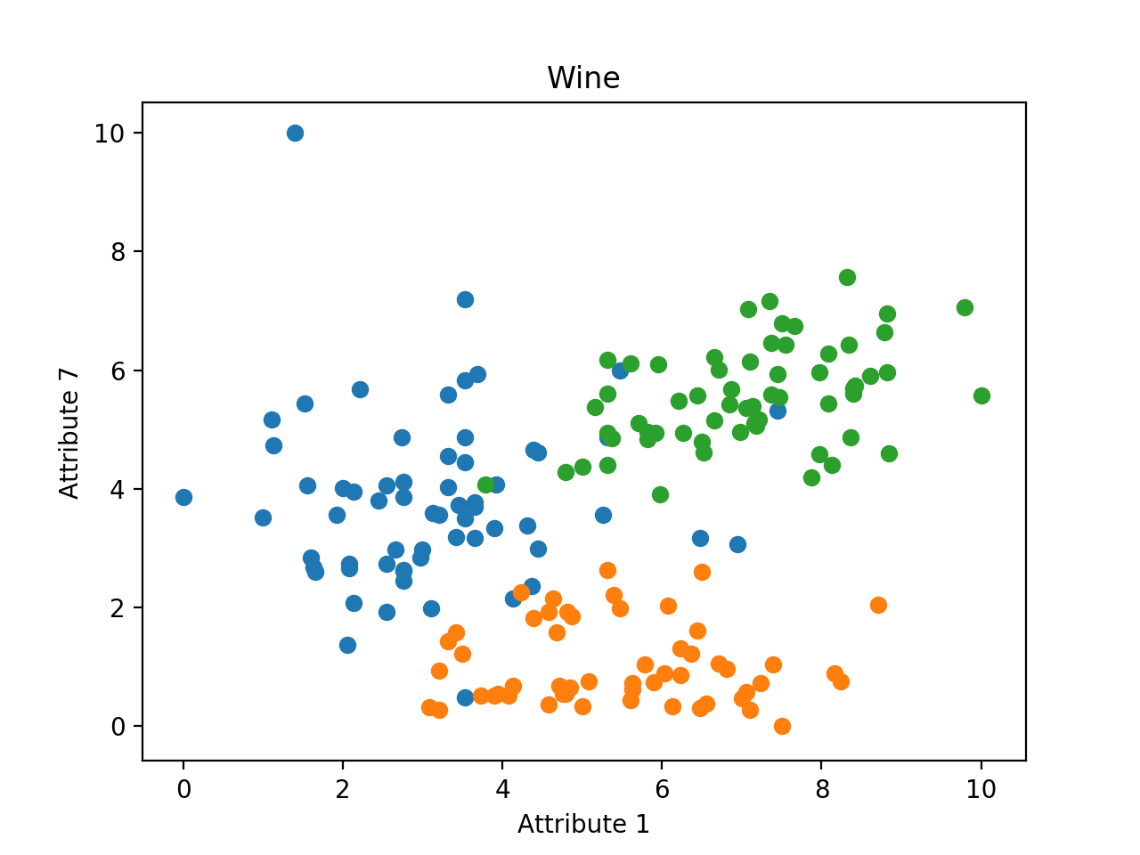
Results - Graph - Wine(after normalization)
clusters from labels
clusters from Lloyd’s method

Slide 15
Conclusions
Both Hamming distance and Classification Error measures
how correctly the data have been clustered
Silhouette coefficient measures
how tightly all the data in the cluster are grouped
how appropriately the data have been clustered

Slide 16
Thank You

